Slide 1
Freedom of speech over the internet
By Kurt Burgess

Slide 2
Intro
Why chose this:
I chose this because I would like to find out how other governments and our own government control what goes over the internet.

Slide 3
Rights to freedom of speech
UK: The UK has a wide range of freedom of speech although there are exceptions including threatening, abusive, or insulting speech or behaviour likely to cause a disruption in the peace, racial hatred, religious hatred, terrorism including encouragement of terrorism.
North Korea: The North Korean constitution is heavily restricted with the newspapers. Article 53 of the North Korean Constitution protects freedom of speech and freedom of the press, but only if expressions are supportive of the government and the ruling party, the Workers' Party of Korea.
America: Freedom of speech in America is protected by the first amendment, also there are exceptions to these general protections, including the Miller test for obscenity, child pornography laws, speech that incites imminent lawless action, and regulation of commercial speech such as advertising.
Africa: African constitutions provide most legal protection for freedom of speech, although it is not enforced enough. One of the poorest in Africa, Eritrea allows no independent media and has the highest imprisonment of journalist with 14 journalist.

Slide 4
Why we have freedom of speech
We have freedom of speech so we can speak out against government without fear of imprisonment, and so we can voice our opinions without fear of being repressed by the government. You are still responsible for what you say though and can be prosecuted by it.

Slide 5
Why freedom of speech can be bad
How they are misused:
The freedom of speech is misused as we are allowed to voice our opinions, people can discriminate or insult against a wide group as this does not affect peoples rights, as soon as they target a specific person, then it is an offence. This is why the KKK and Neo-Nazis are allowed to do protests and marches in public.

Slide 6
Arguments:
Reasons against it:
1) People are finding out too much about what is happening in the world.
2) Because people who voice their opinion can do so by insulting a group or person.
3) There is not enough control over the internet.
Reasons for it:
1) Because people can share information on what is happening when their government censors it.
2) People deserve to voice their opinion.
3) You can rarely be persecuted for voicing your opinion.

Slide 7
Case Study
North Korea’s views on the internet:
North Korea are classed as enemy's of the internet; they only allow a few hundred thousand citizens which represents approximately 4% of the population on the internet, which is severely governed.
Most citizens have access to the governments intranet server, which is called Kwangmyong, this has only a few selected websites controlled by the government; these websites are full of propaganda.

Slide 8
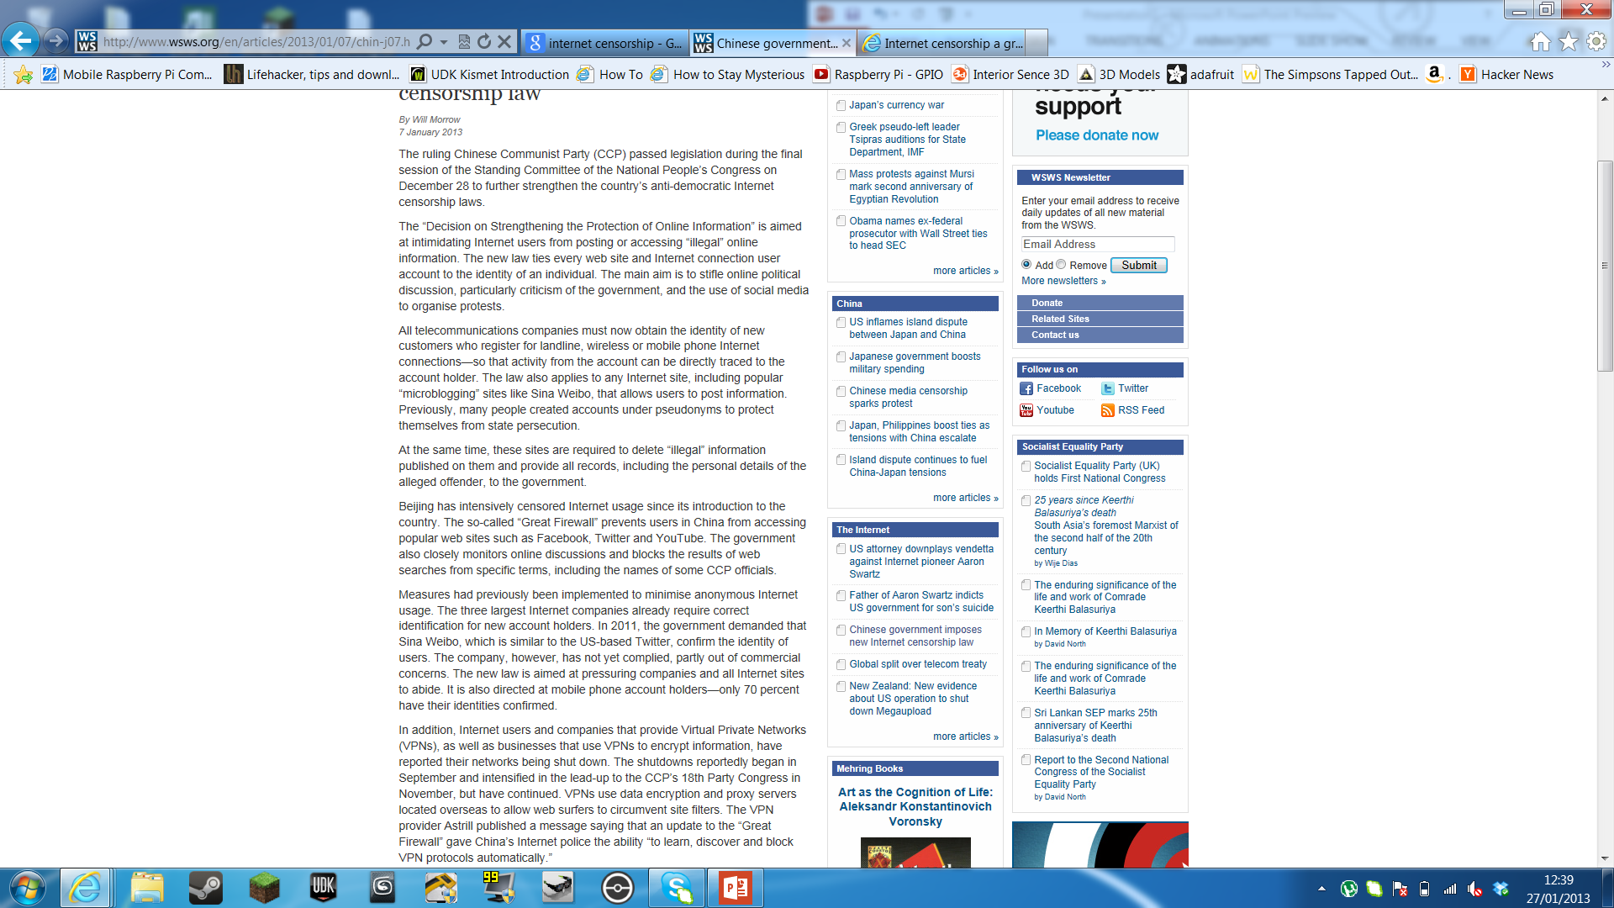
Annotated Article 1
In this article, the Chinese government are enforcing new rules tying every device and username to a specific person so any activity can be traced back to that person.
They are also blocking many VPN companies which provide an encrypted and safer mean of traveling through the internet as they make it harder for the Chinese government to trace what is seen and posted to a specific person.
http://www.wsws.org/en/articles/2013/01/07/chin-j07.html
I believe this is wrong as it stops any animosity over the internet and is destroying businesses who deal with VNPs.

Slide 9
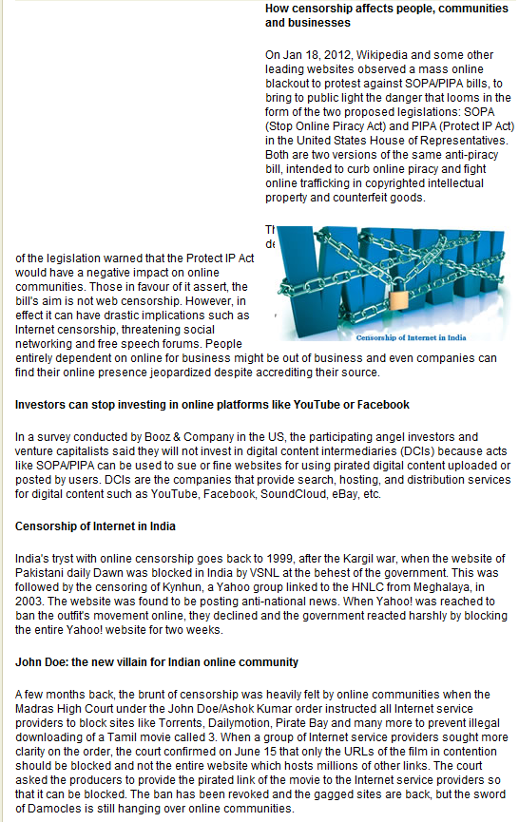
Annotate Article 2
This article shows us how censorship could affect people and businesses.
It does this by explaining how SOPA and PIPA could stop investors and share holders could stop investing in websites, thus leading to the websites being shut down do to lack of funding.
http://pcquest.ciol.com/content/techtrends/2012/112123102.asp

Slide 10
International Government on Internet freedom of speech
UK: Last summer, in the wake of the London riots, Prime Minister David Cameron insisted that the government should have the power to censor social media and "stop alleged rioters from communicating via these websites". Cameron said his proposal was meant "to keep our country safe from serious and organised crime and also from terrorist threats that… that we still face in this country".
North Korea: Only a very few government officials have access to the internet through a secret rented Chinese connection. The rest of the citizens have access to the country's own internet, called Kwangmyong. Only 4% of the population have access to this and all content uploaded must be approved by the government, blogging is also banned as it allows people to speak their mind.
America: The First Amendment to the U.S. Constitution, says that "Congress shall make no law abridging the freedom of speech, or of the press. This however does not cover the internet nor does it cover hate speech, these amendments where created long before the internet was created and some believe that they need to be “updated” to comply with todays standards. However this means that there are virtually no limit to what you can post, but this does not cover the other rules and laws that have been put in place by the government.
Africa: I could not find anything relating to this topic. This is reinforced by the statistic on slide 11 which shows not much or no data has been collected from that country.

Slide 11
Why is it freedom of speech controlled over the internet
Freedom of speech is controlled over the internet to protect people from any insult or abuse. Some governments take it to another level when they prevent you from seeing information which gives another point of view which is not approved by their government. Such as ideas that oppose the government or ideas that could spark a revolution.
But most countries put limits in place for good reasons, such as protection from child pornography, copyrights.

Slide 12
How it is speech controlled over the internet
Many governments monitor the activity from each ip address, viewing what websites they go to and what they do on each of them. Many websites including Google and multiple social media outlets encrypt the data that is being sent to and from each IP address, this means the government can see what websites their on but not what they are doing on them. Many governments combat this by completely blocking the website. Eg: North Korea have completely blocked the use of any website you are allowed to voice your opinion, this means there is no interaction with other countries. Other governments are asking to be allowed to decrypt the information given by Google and multiple social media outlets.

Slide 13
Findings in my Questionnaire
Through the findings of my questionnaire I have found:
People believe we need freedom of speech over the internet.
People do not have enough freedom of speech over the internet.
It is undecided if there is too much control over the internet.
People believe we do not need any more limitations over the internet.
People do not know what they can and can’t say over the internet.

Slide 14
Conclusion:
I believe some censorship is necessary to keep the peace and to make sure everything is equal among all humans, whereas some countries doo take it a bit too far; limiting what their citizens can view for the governments sake and not the protection of the people.

Slide 15
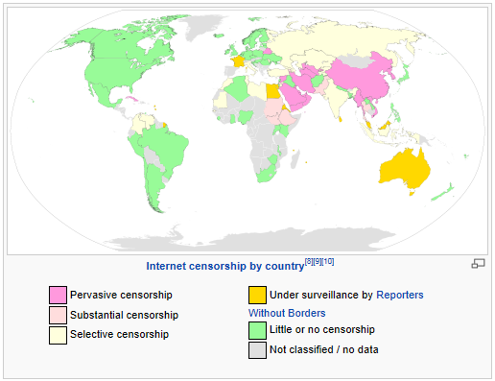

Slide 16
Links Used:
http://en.wikipedia.org/wiki/Freedom_of_speech_by_country 15/11/2012
http://en.wikipedia.org/wiki/Freedom_of_speech_by_country#United_Kingdom 22/11/2012
http://en.wikipedia.org/wiki/Freedom_of_speech_by_country#South_Korea 22/11/2012
http://answers.yahoo.com/question/index?qid=20120327074314AAvTH4Z 6/12/2012

